Slide 1

Employee Self Service
(ESS)
Version 2.22

Slide 2
Employee Self Service
Employees can…
access from any computer.
view their elected withholding, earnings summary, check history, company documents, leave balances and leave history.
request changes to their demographics, direct deposits, W4 and state tax withholding forms.
upload documents for demographic and direct deposit request.
print past check information.
print W2s for past years.

Slide 3
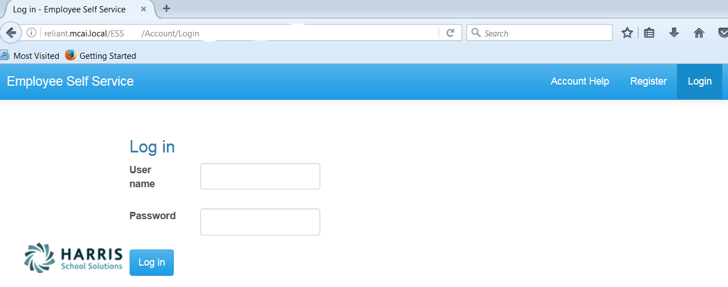
Registration on Log In screen
Employee Self Service – Register
Enter Web Address for ESS into your browser.
Everyone must register as a user for ESS using their social security number and employee number.
NOTE: Internet Explorer version 9 and below are not supported in ESS. The Internet Explorer browser must be version 10 or above.

Slide 4
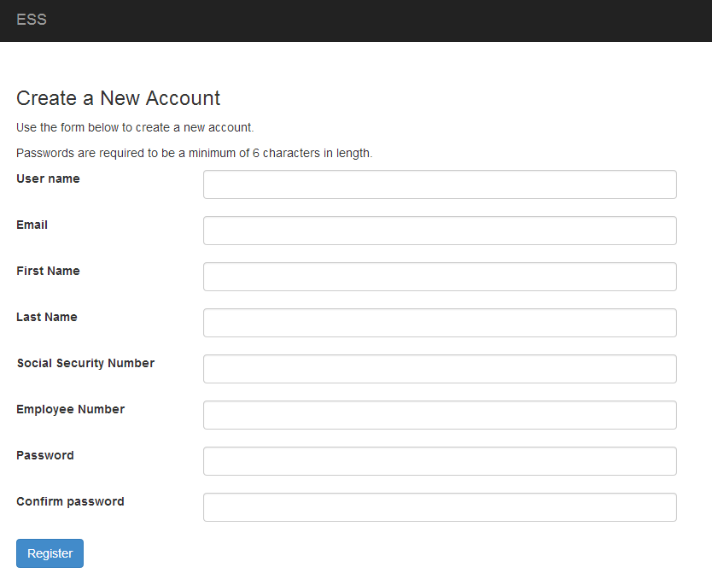
All employees must create an account in ESS.
Employee Self Service - Register
Employee chooses their own User Name and Password. User name should not contain any special characters or spaces.
Social Security Number and Employee Number combination is validated in the payroll system.
Email address will be used to send all notifications from ESS. This does NOT have to be a school district assigned email address. It may be an employee’s personal email address.

Slide 5
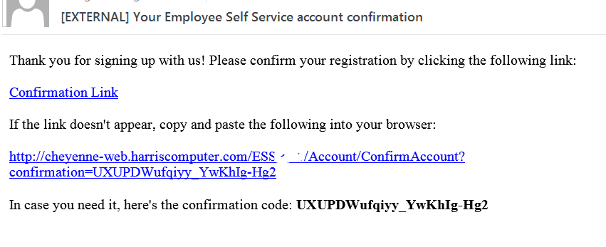
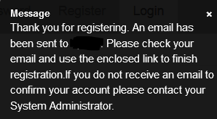
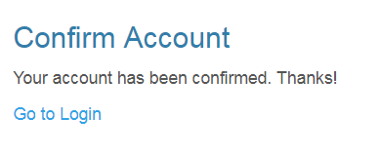
All employees must confirm their new ESS account before being allow access to ESS.
Employee Self Service - Register
An email, with a confirmation link, will be sent to the email address the user provided when creating their account. The email will also include a full confirmation link that can be copied and pasted into your browser. User must use one of the confirmation link in the email to be confirmed as an authorized user for ESS. Once the employee has been confirmed as a user, they can login in with their user name and password.

Slide 6
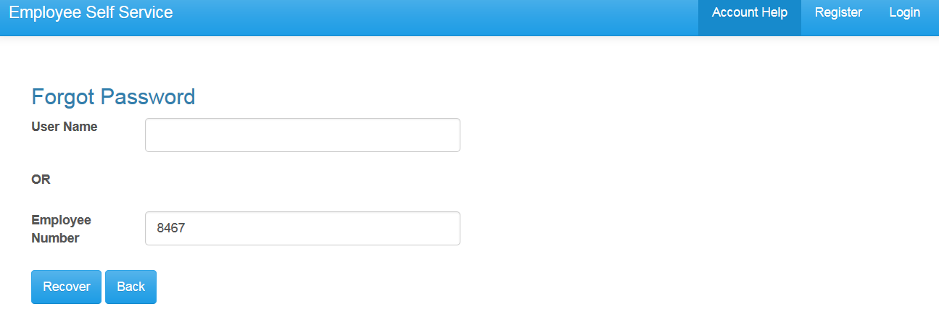
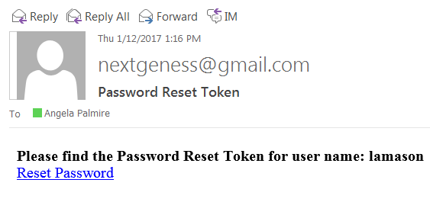
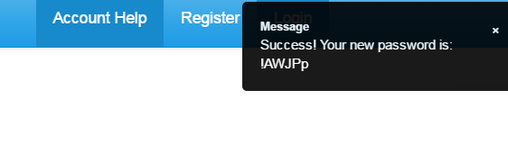
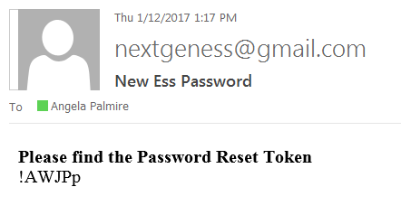
Account Help allows the employee to recover their password.
Employee Self Service – Account Help
The Account Help allows a registered employee to recover their password with the Forgot Password recovery. The employee must enter their User Name or Employee Number and press the Recover button. An email with a ‘reset password’ link will be sent to employee’s ESS email address. Once the employee clicks on the link in the email, a computer generated password is assigned to their user name. The employee will receive a message and a email with the new password. The employee can then login with the new password. The password can be changed (instructions on page 40). The Forgot Password will not work if the employee’s account has not been confirmed (see previous screen).

Slide 7
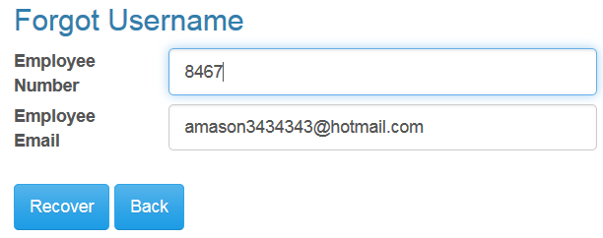
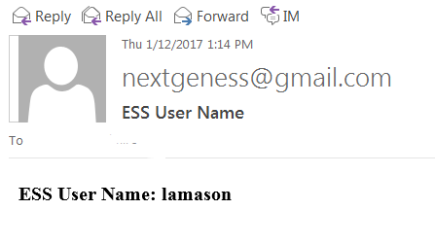
Account Help allows the employee to recover their user name.
Employee Self Service – Account Help
The Account Help allows a registered employee to recover their user name with the Forgot Username recovery. The employee must enter their Employee Number and their ESS email address and press the Recover button. An email with their user name will be sent to the employee’s ESS email address. If the email address entered does not agree with the email address the employee register with, a message will be displayed and no email will be sent. The Forgot Username will not work if the employee’s account has not been confirmed (see page 4).

Slide 8
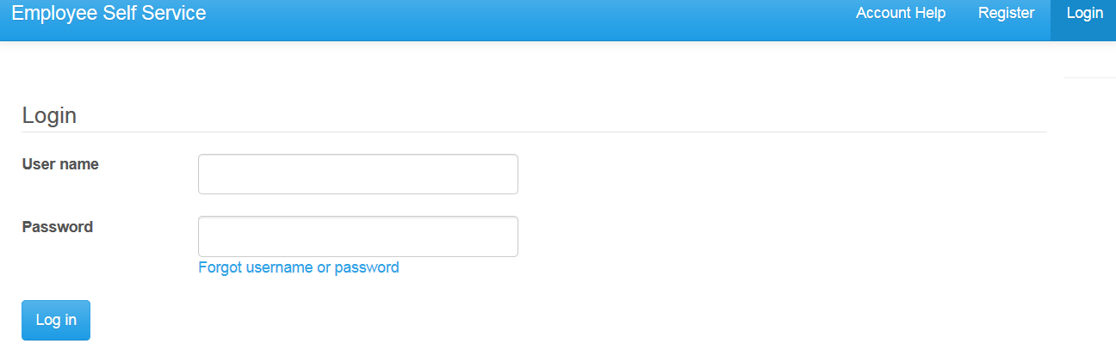
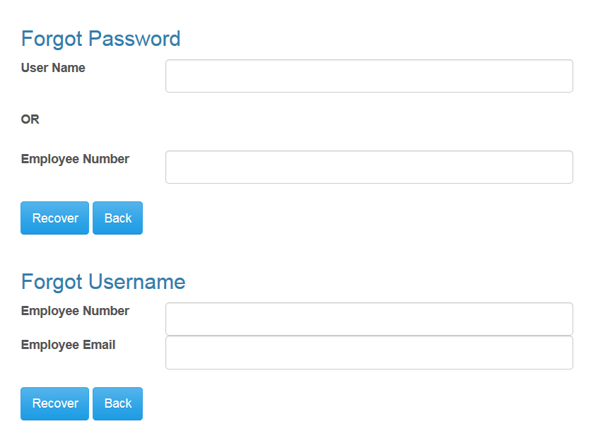
Account Help allows the employee to recover their user name.
Employee Self Service – Account Help
The Forgot username or password link on login screen is a fast link to the Forgot Password and Forgot Username functionality under the Account Help.

Slide 9
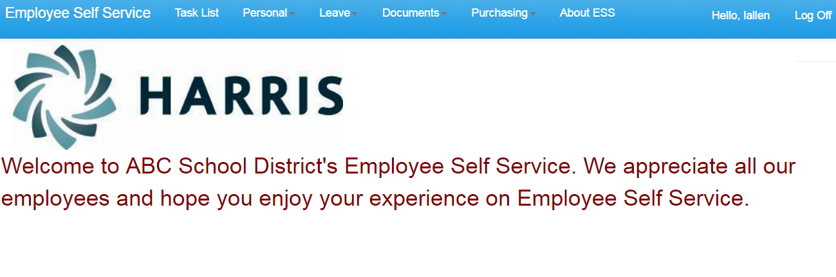
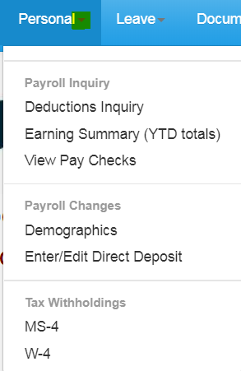
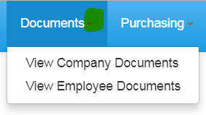
The Main screen will display the Logo and Welcome Message with the menu options available on the toolbar. Each menu options can be expanded to display transactions available. If user is an Administrator for ESS, they will also see Site Administration in their menu options.
Employee Self Service – Menu

Slide 10
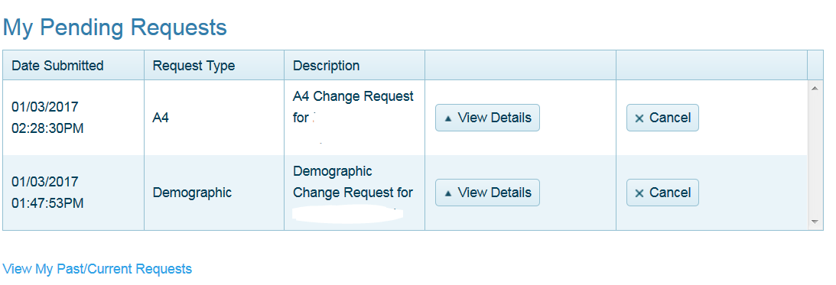
Employee can view or cancel pending requests and view past requests.
Employee Self Service - Task List
Task List will displays a summary of all the employee’s pending change requests.
Completed Requests (approved or rejected) can be viewed by the employee with the View My Past/Current Requests.
Details for the pending request can be viewed by employee.
Pending requests (unapproved) can be cancelled by employee.

Slide 11
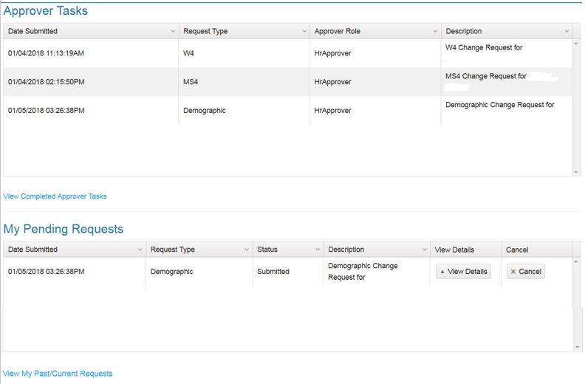
An employee who is also an Approver will have both their requests and the Approver Tasks displayed on their Tasks menu.
Employee Self Service – Task List
The Approver can approve or reject pending requests from employees on the Task List menu under Approver Task.
Approvers can view request history with the View Completed Approver Tasks.
Completed requests (approved or rejected) can be viewed by the employee with the View My Past/Current Requests.

Slide 12
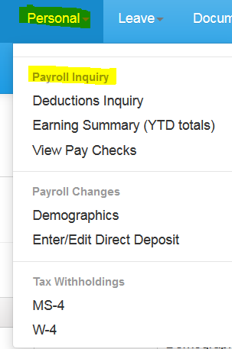
The Personal menu contains the sub-menu for Payroll Inquiry which includes the Inquiries available for the employee.
Employee Self Service–Personal/Payroll Inquiry

Slide 13
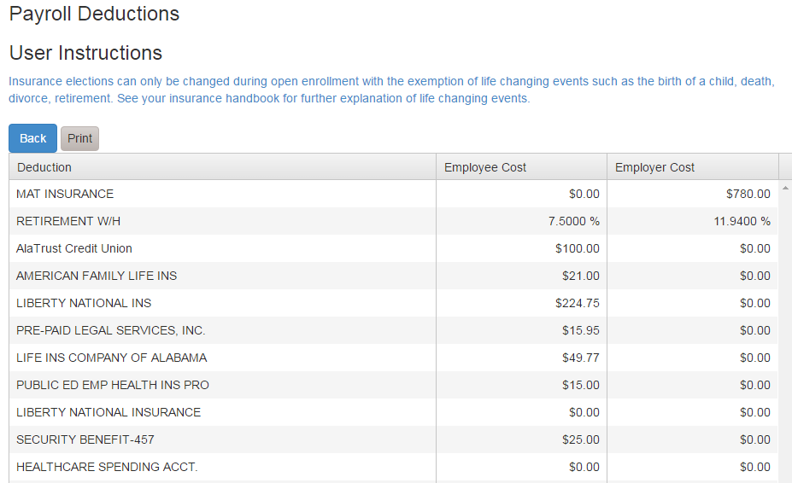
The Deduction Inquiry allows for viewing and printing the employee and employer cost for employee elected deductions.
Employee Self Service – Deduction Inquiry

Slide 14
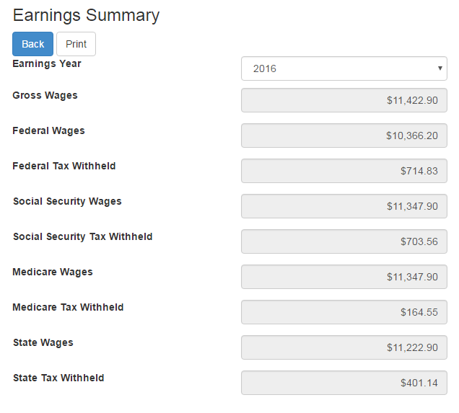
Employees can view and print their earnings summary by selecting the year they wish to view.
Employee Self Service – Earnings Summary

Slide 15
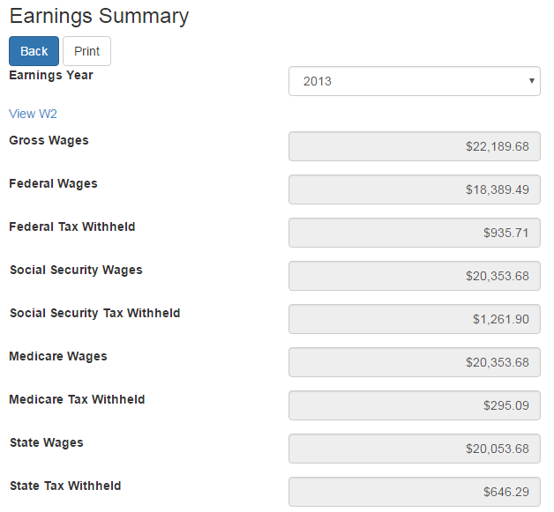
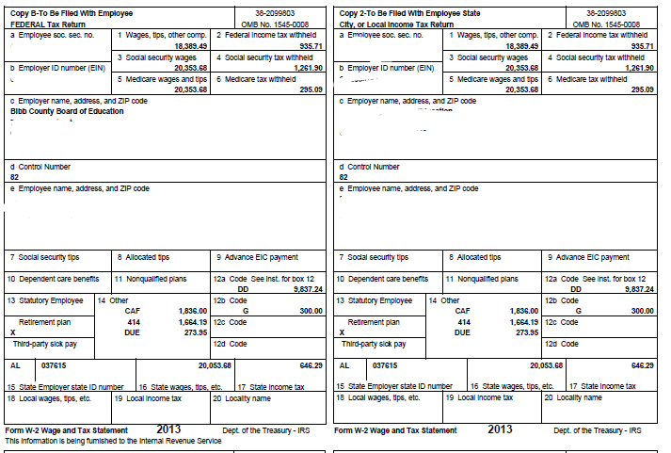

If the district uses Harris School Solutions' Document Services product to produce their W2 records, the employee can view and print their W2 for the selected year.
Employee Self Service-Earnings Summary (W2)

Slide 16
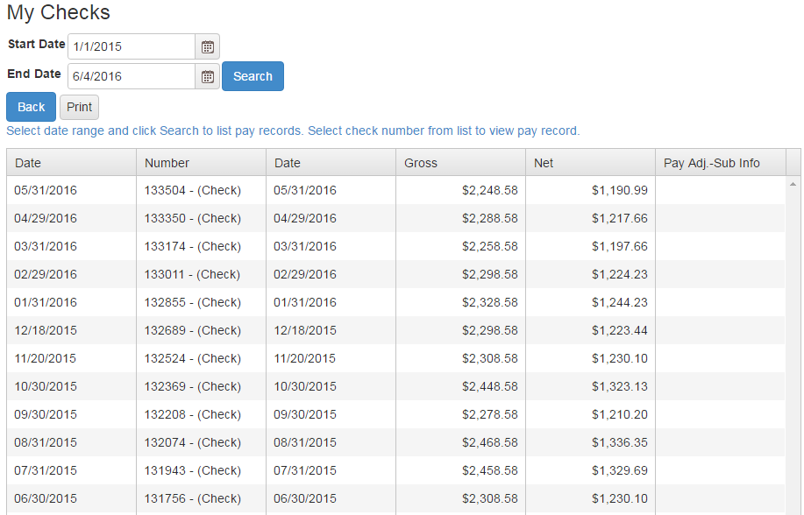
Employee can view and print check/statement summary for a specific check date range. The employee can view check detail by clicking on a particular check.
Employee Self Service – View Pay Checks

Slide 17
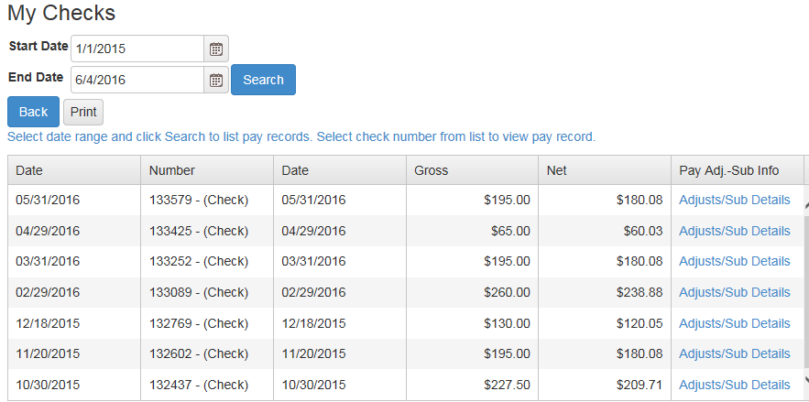
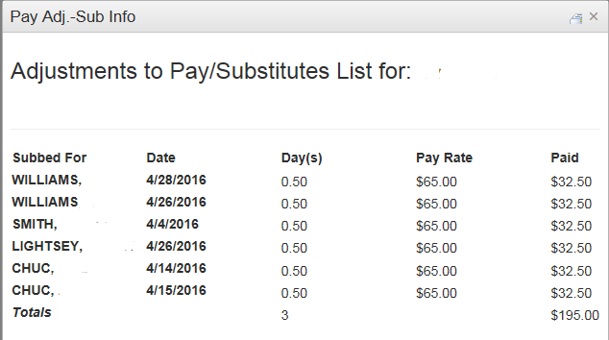
If an employee has extra pay, pay adjustments or substitute pay for a specific check, they can view detail information about the pay by clicking on Adjusts/Sub Details link.
Employee Self Service – View Pay Checks

Slide 18
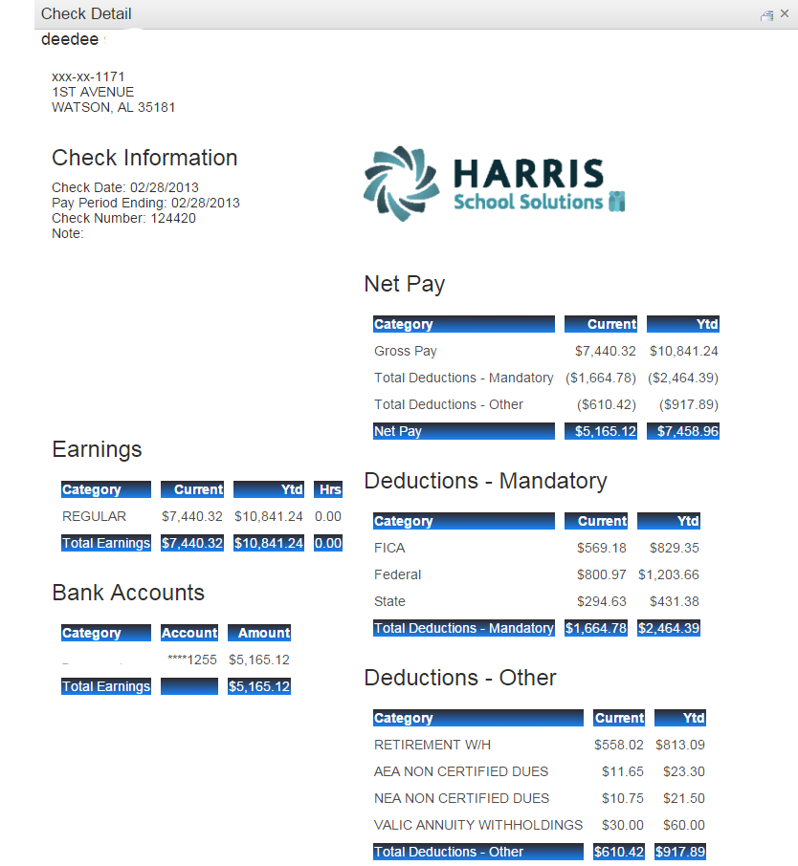
Employee’s detail check information can be displayed and printed.
Employee Self Service – View Pay Checks
Print button.

Slide 19
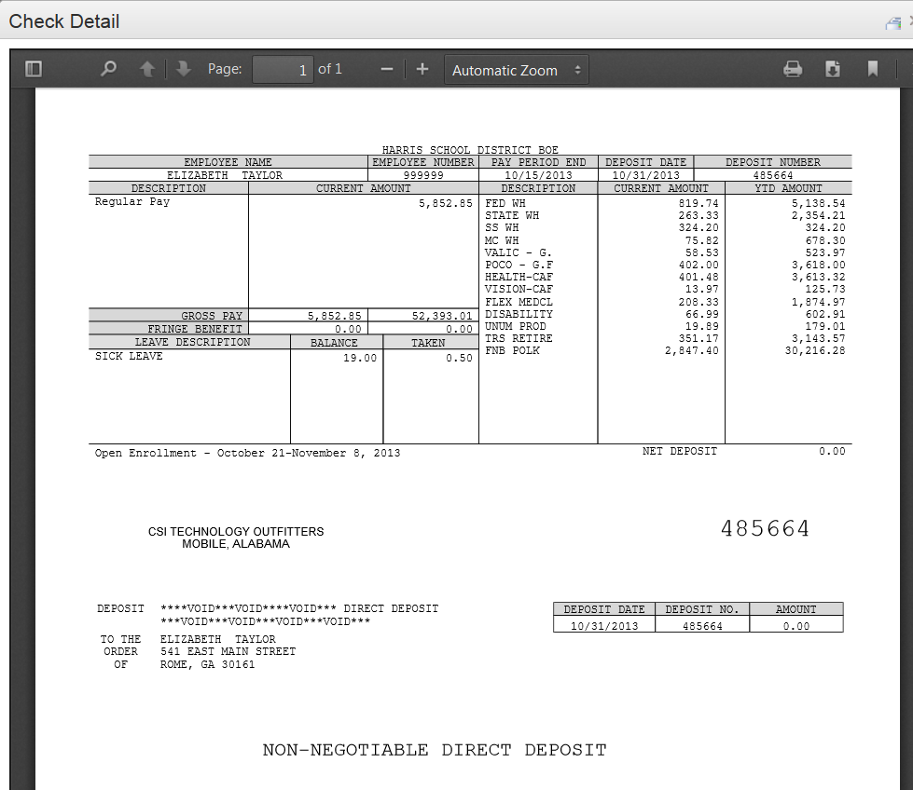
If the district is using Harris School Solutions' Document Service product to produce their checks and statements, the check/statement detail will display as a copy of the original check/statement. The employee can also print a copy of the displayed check/statement.
Employee Self Service – View Pay Checks
Print toolbar is at bottom of check display.

Slide 20
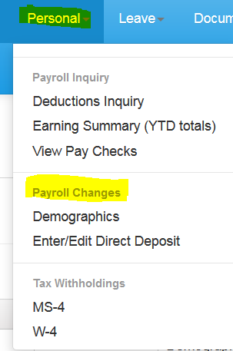
The Personal menu contains the sub-menu for Payroll Changes which includes a menu of all change options available to the employee.
Employee Self Service–Personal/Payroll Changes

Slide 21
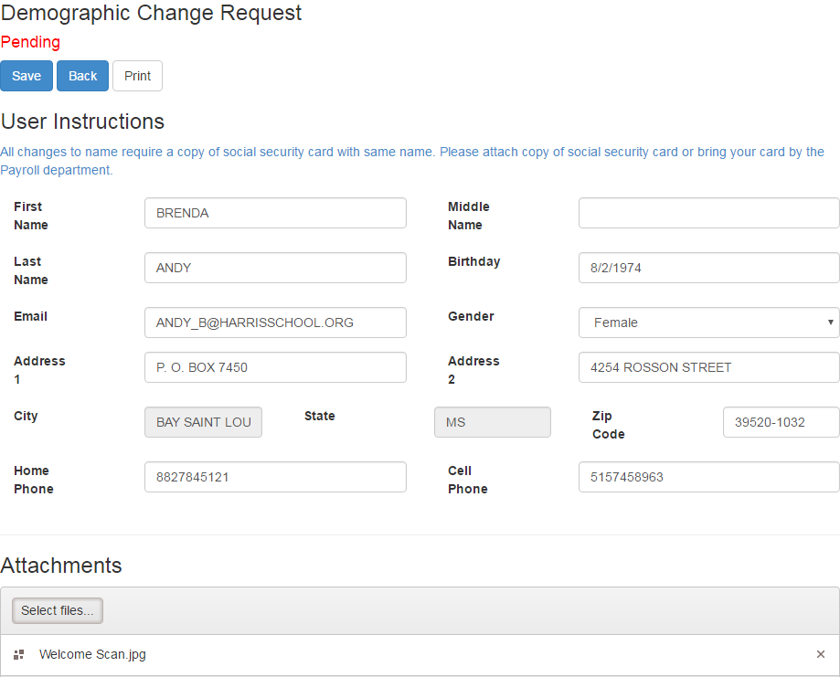
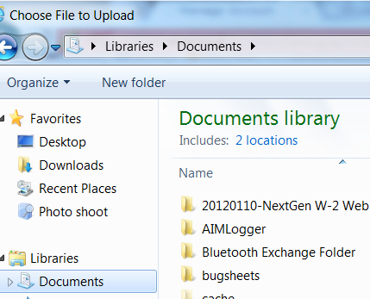
Employee can request changes to a variety of demographic fields and upload multiple documents to be submitted with their change request. Both the employee and the approver can print the attached documents from the pending or completed request/task.
Employee Self Service - Demographics
If employee has a pending request, their demographics will be displayed with the requested changes. The employee can change all demographic data.
Information can be printed by selecting Print.
Multiple files can be selected from multiple directories. Acceptable file formats include .gif, .jpg, .jpeg, .png, .doc, .docx, .xls, .xlsx, .pdf, .txt.
NOTE: A change to the email address on the demographic screen changes the email address in the payroll system which may be used by the school district when corresponding with the employee. It does not change the email address for the ESS notifications which was entered when the employee registered for ESS.

Slide 22
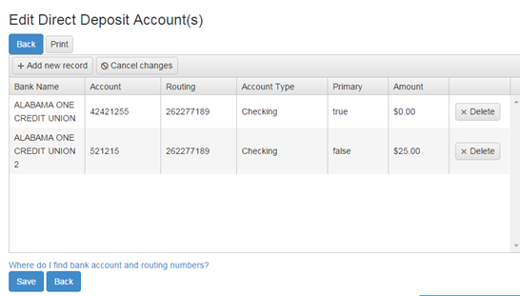
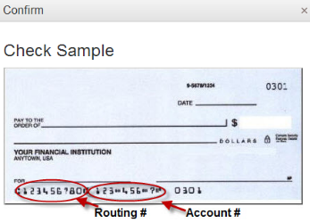
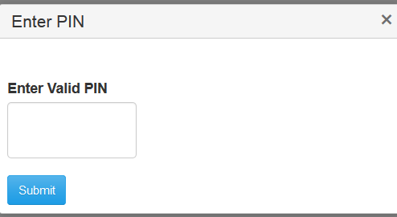
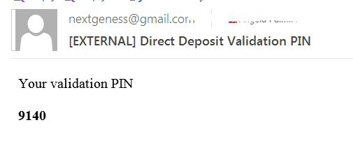
Employees can submit requests to add, delete, or change direct deposit accounts. All changes must be validated with a PIN that is emailed to the employee’s ESS email. Once the valid PIN is submitted, the request for changes will be submitted for approval.
Employee Self Service-Edit/Enter Direct Deposit
If changing a routing number or the amount to deposit, click in the field, make the change and click save.
If adding a new account, click on Add New Record, enter the information for the new account and click save. Note: There can be only one primary account per employee.
If you are trying to delete a direct deposit, click on the Delete button beside the account information and then click save.

Slide 23
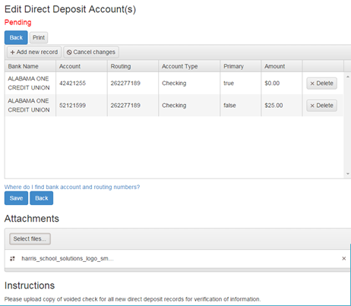
Pending changes are displayed and employees can upload files for direct deposit requests.
Employee Self Service-Edit/Enter Direct Deposit
If employee has a pending request, their direct deposit information will be displayed with the requested changes. The employee can change all pending direct deposit data.
Multiple files can be selected from multiple directories. Acceptable file formats include .gif, .jpg, .jpeg, .png, .doc, .docx, .xls, .xlsx, .pdf, .txt.

Slide 24
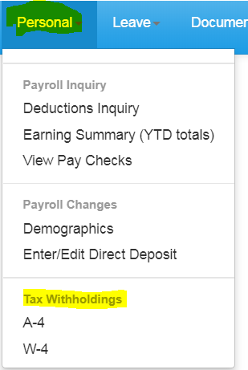
Tax Withholding under the sub menu Payroll Changes will include your State Withholding and W-4 Withholding Forms.
Employee Self Service – Tax Withholdings

Slide 25
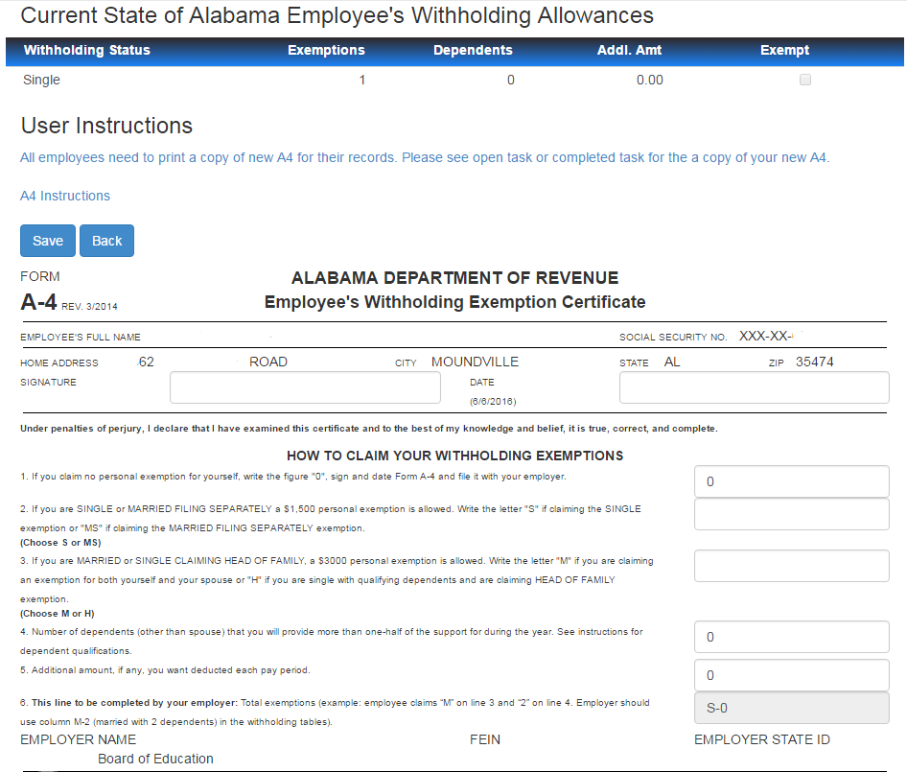
Changes can be made to the employee’s A4 with an electronic signature.
Employee Self Service – A4 (Alabama)
Employee’s current State withholding information is displayed.
Employee can view additional instructions for the A4 by clicking the A4 Instructions button.
Electronic signature and date must be exactly as displayed – no extra spaces, dashes or periods.
If requesting a change for A4, the employee must enter ALL information on the A4 form, not just the change.

Slide 26
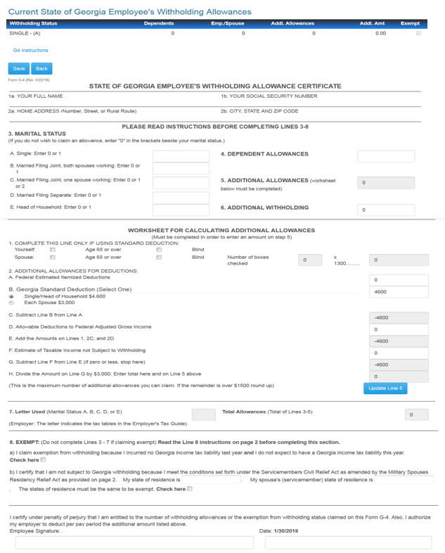
Changes can be made to the employee’s G4 with an electronic signature.
Employee Self Service – G4 (Georgia)
Employee’s current State withholding information is displayed.
Employee can view instructions for the G4 by clicking the G4 Instructions button.
If requesting a change for G4, the employee must enter ALL information on the G4 form, not just the change.
Line 5 - Additional Allowances is updated from the worksheet entries and the Update Line 5 button.
Electronic signature and date must be exactly as displayed – no extra spaces, dashes or periods.

Slide 27
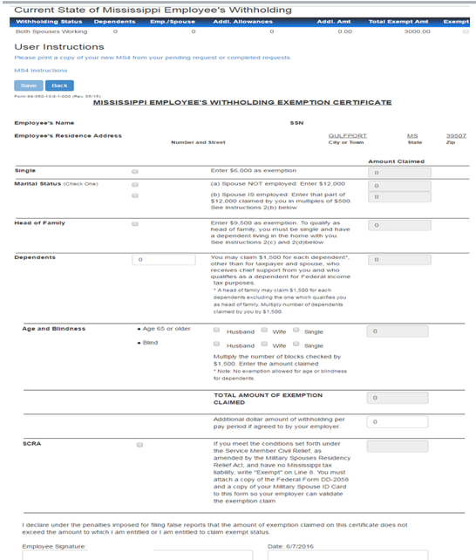
Changes can be made to the employee’s MS4 with an electronic signature.
Employee Self Service – MS4 (Mississippi)
Employee’s current State withholding information is displayed.
Employee can view instructions for the MS4 by clicking the MS4 Instructions button.
If requesting a change for MS4, the employee must enter ALL information on the MS4 form, not just the change.
The Total Amount of Exemption Claimed will be the total of selected status amount, dependent amount and additional allowances.
Electronic signature and date must be exactly as displayed – no extra spaces, dashes or periods.

Slide 28
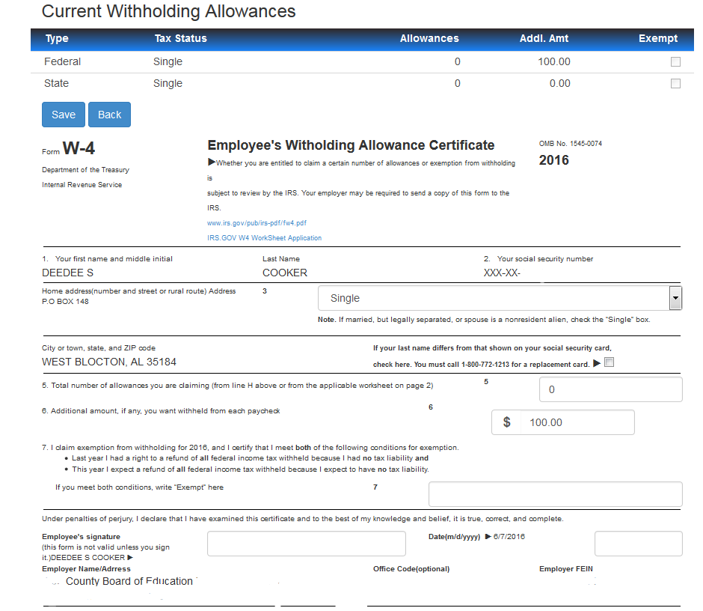
Changes can be made to the employee’s W4 with an electronic signature.
Employee Self Service – W4
Employee’s current Federal and State withholding information is displayed.
IRS instructions and worksheet are accessible from W4 form.
If requesting a change for W4, the employee must enter ALL information on the W4 form, not just the change.
Electronic signature and date must be exactly as displayed – no extra spaces, dashes or periods.

Slide 29
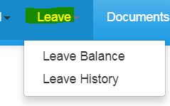
Leave Menu allows the employee to see their leave history and leave balances.
Employee Self Service – Leave

Slide 30
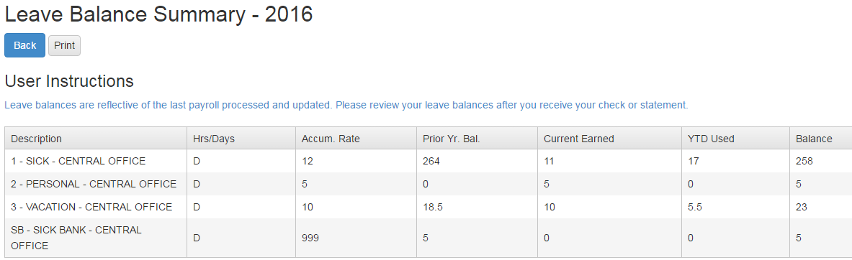
Employee can view and print their current leave balances. The leave earned and used are reflective of the last completed payroll.
Employee Self Service – Leave Balance

Slide 31
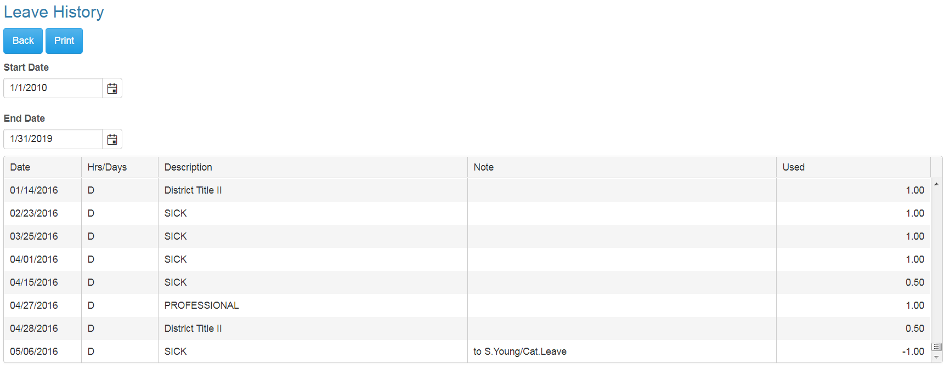
Employee can view and print their detail leave history for a specific date range. Leave adjustment are displayed with the notes that related to the leave adjustment.
Employee Self Service – Leave History

Slide 32
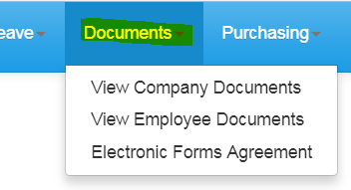
Documents menu allows the employee to view company documents or the employee’s personal documents. The Electronic Forms Agreement will be available in the menu IF your district is using this option.
Employee Self Service–Documents

Slide 33
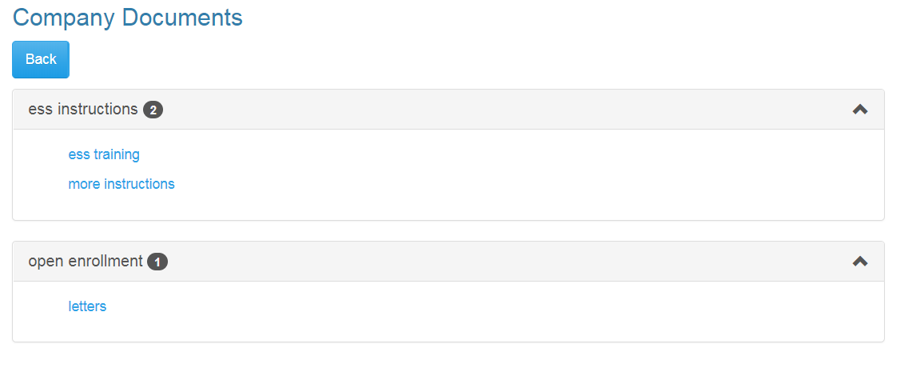
View Company Documents allows employees view and print any documents uploaded by the Document Administrator. This is a great way to give employee access to Policy and Procedure Manuals, retirement documents, and Open Enrollment documents.
Employee Self Service–View Company Documents

Slide 34
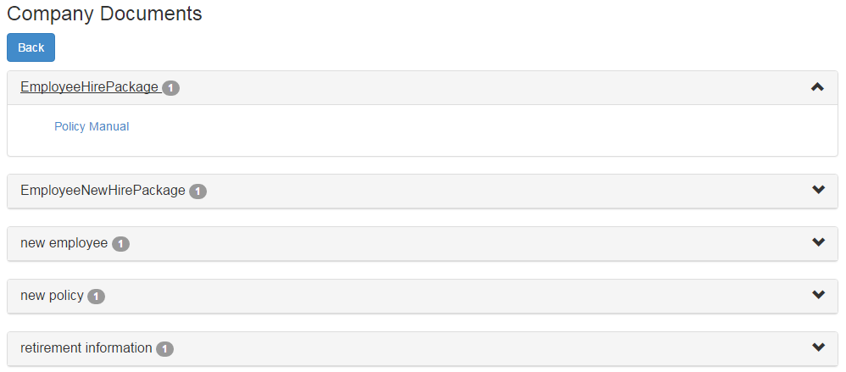
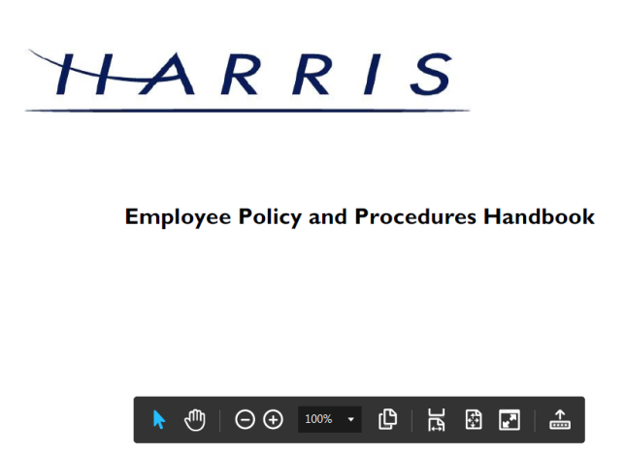
Employee can view and print documents that their District has placed in Company Documents by clicking the category and selecting the document.
Employee Self Service–View Company Documents
AB

Slide 35
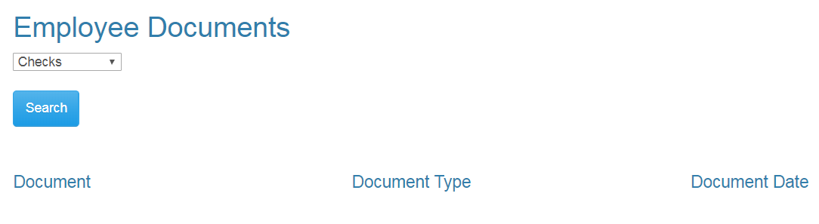
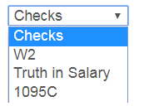
Employee can view and print their detail check, W2, Truth In Salary or 1095C forms if these documents are available.
Employee Self Service–View Employee Documents
AB

Slide 36


Employee can view and print their detail check information by selecting checks from drop down and pressing the search button. A list of all the employee check/statements will be displayed. Employee will then click on the check/statement to view and the check will open in a separate browser tab. The check/statement can then be printed or saved. Each tab that is opened with detail records must be closed manually when logging out of ESS.
Employee Self Service–View Employee Documents
AB

Slide 37

Employee can view and print their W2 records by selecting W2 from drop down and pressing the search button. A list of all the employee W2s by year will be displayed. Employee will click on the W2 to view the detail record. The document will open in a separate browser tab. The W2 can then be printed or saved. Each tab that is opened with detail records must be closed manually when logging out of ESS.
Employee Self Service–View Employee Documents
AB

Slide 38


Employee can view and print their Truth In Salary documents by selecting Truth In Salary from drop down and pressing the search button. A list of all the employee’s document by year will be displayed. Employee will click on the document to view the detail. The document will open in a separate browser tab. The document can then be printed or saved. Each tab that is opened with a detail record must be closed manually when logging out of ESS.
Employee Self Service–View Employee Documents
AB

Slide 39


Employee can view and print their 1095C documents by selecting 1095C from drop down and pressing the search button. A list of all the employee’s document by year will be displayed. Employee will click on the document to view the detail. The document will open in a separate browser tab. The document can then be printed or saved. Each tab that is opened with a detail record must be closed manually when logging out of ESS.
Employee Self Service–View Employee Documents
AB

Slide 40

Employee can change their choice for tax form delivery by selecting the option and save. Districts can also require that the Agreement be signed by all employees on initial login to ESS. This option may not be used by all districts.
Employee Self Service - Electronic Form Agreement
Example Text Only

Slide 41


The About ESS Menu option identifies the Product Version and the District. The District’s contact information for Employee Self Service can also be displayed here.
Employee Self Service – About ESS

Slide 42

An employee can manage their ESS account by clicking on their user name in the toolbar.
Employee Self Service – Manage Account
Employee clicks on their user name to manage their account.
The employee can change their password by entering their current password and the new password.
The employee can change the name and email address associated with their ESS account.
The employee can choose not to receive email alerts for requests and approvals in ESS.

Slide 43


Any changes made in Manage Account must be validated with a PIN that is emailed to the employee’s ESS email. Once the valid PIN is entered and submitted, the changes to the employee’s account will be saved.
Employee Self Service – Manage Account

